Slide 1
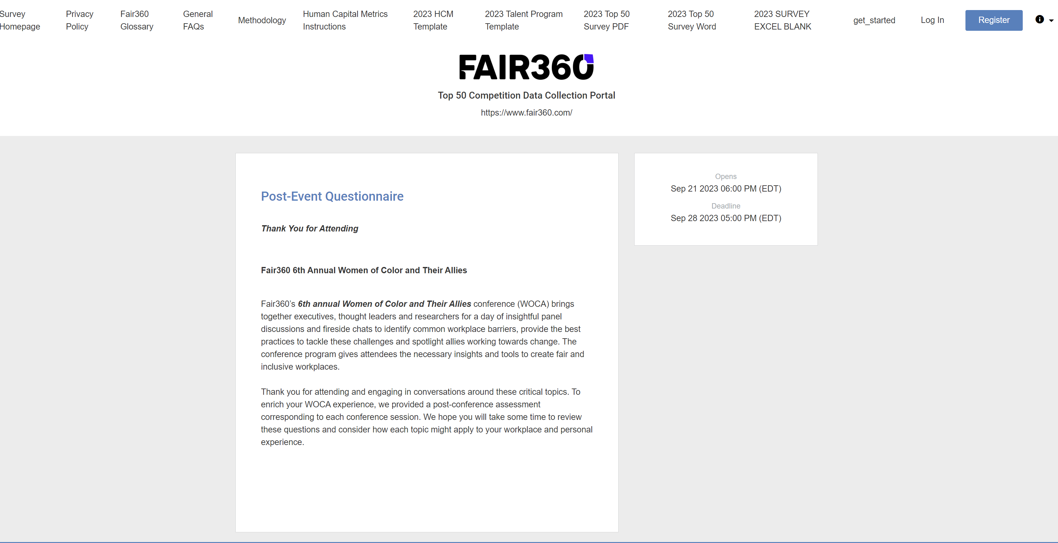
Step 1
Register if it’s your first attempt at completing the survey. Otherwise, login using your previous credentials, which will direct you to step 6.
1

Slide 2
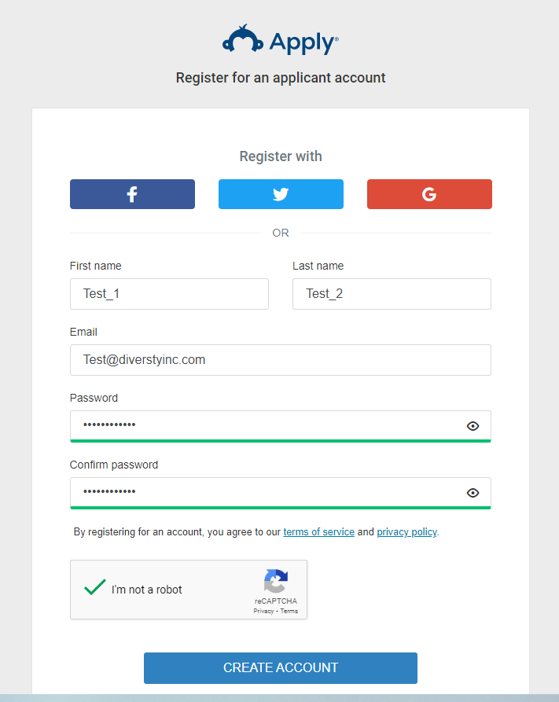
Step 2
Enter the submitter’s info and then create an account for your organization.
2

Slide 3
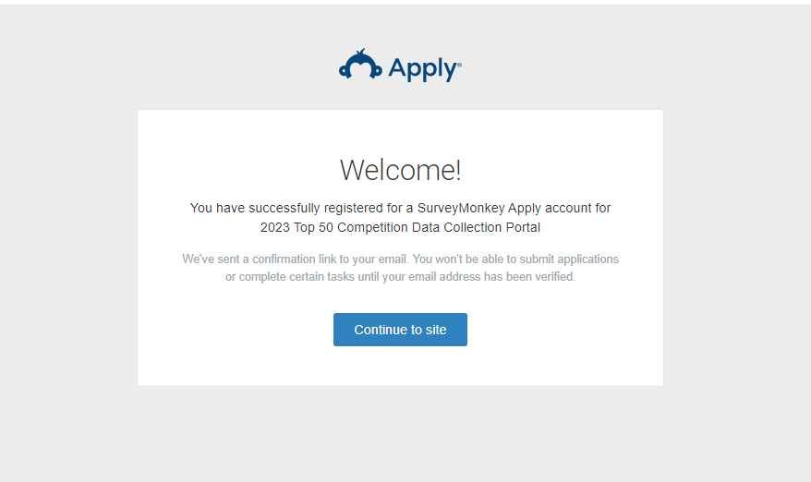
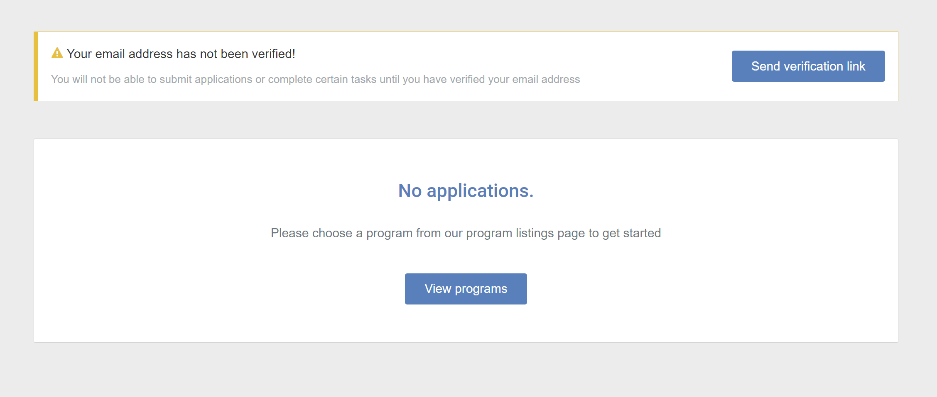
Step 3
1. Click here
2. Verify your email
3. Then click here
3

Slide 4
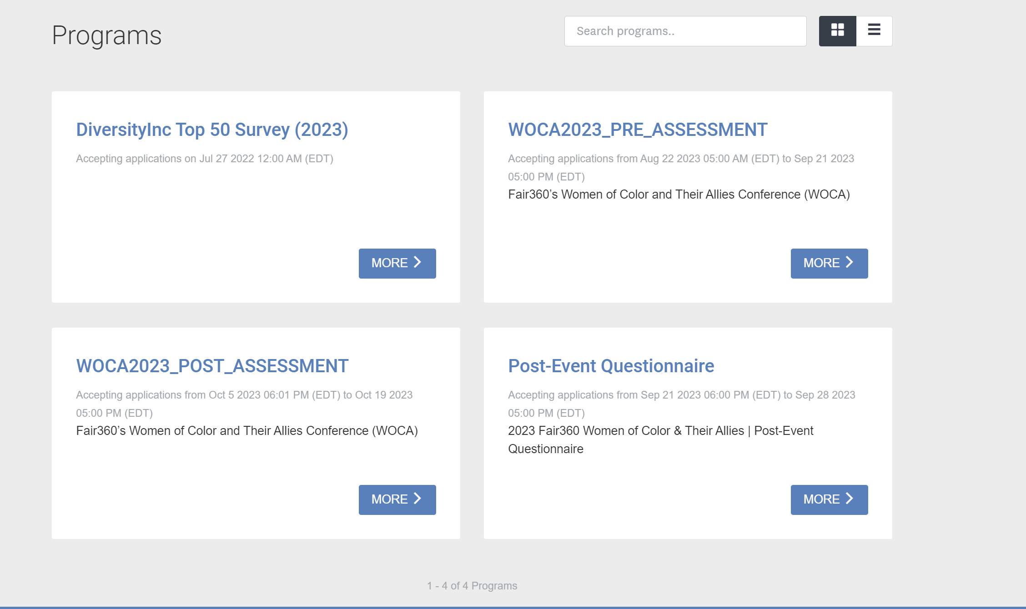
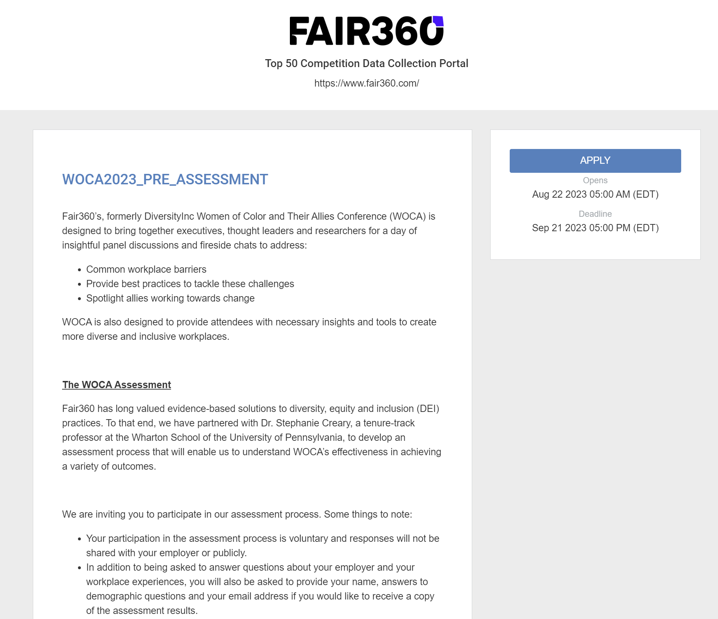
Step 4
1. Choose the survey you’d like to fill out. For example: WOCA2023_PRE_ASSESSMENT
2. Then click here
4

Slide 5
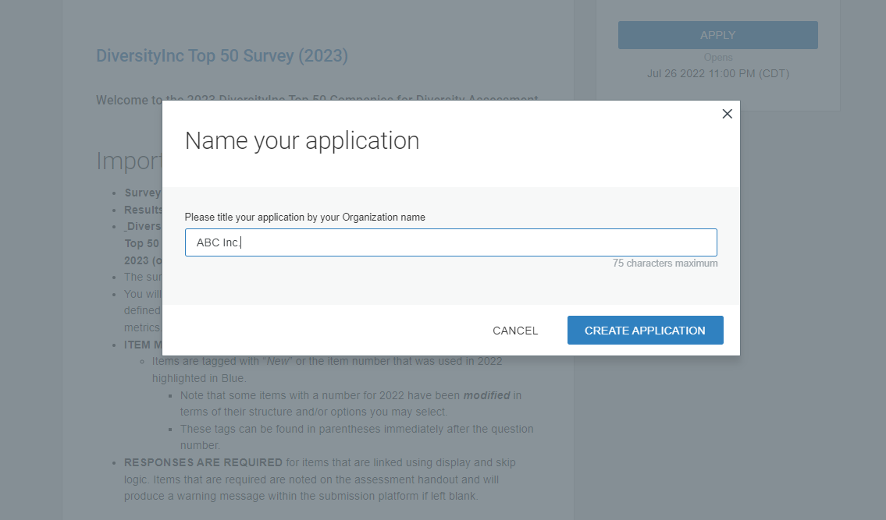
Step 5
Enter your organization's title and then create the application.
5

Slide 6
Step 6
3. Useful information regarding our Methodology, Policy, FAQs, and Instruction
1. You can start inserting data in the survey
2. You can access your credentials and application status in top toolbar
6

Slide 7
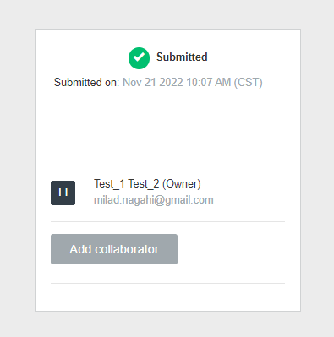
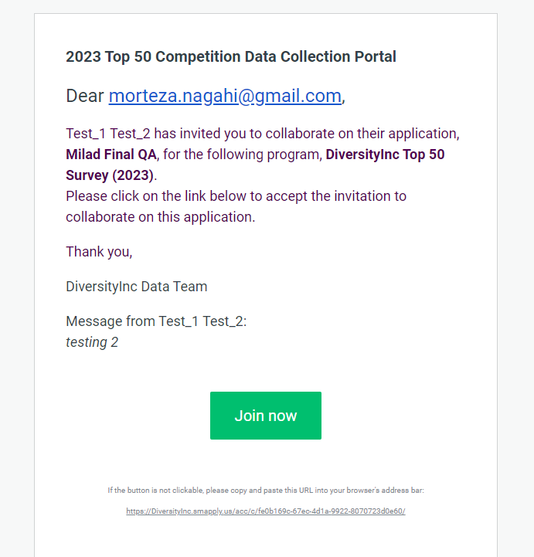
Step 7
1. You can invite collaborators
ABC Inc.
2. Use collaborators’ email for the invitation and define the type of access (you can change/ revoke the granted access anytime)
3. Collaborators can join through the provided link
7

Slide 8
Questions? Please email us at top50@fair360.com
8

Slide 9
Questions? Please email us at top50@fair360.com support@fair360.com
9

